Slide 1
World Happiness Report Dataset
Data Visualization and Prediction
CZ1015 INTRO TO DATA SCIENCE
MINI-PROJECT PRESENTATION
DONE BY: XIAO YANG
WONG CHUN FOONG
KEANE NGUYEN KIM XUYEN

Slide 2
First, let’s look into our…
Background
What will be the
World’s Happiness Score in the next 5 years?
DATASET
CHOSEN
CLEAN
DATASET
UNDERSTAND
DATASET
First, we choose the 2019 WHR dataset
Next, we prepare the dataset by filling N.A.s with 0s and mapping regions and country codes to respective country
Then, we use the data to visualize and predict the data to answer our above question
Visualization
Analysis
Prediction
Outcome
Conclusion

Slide 3
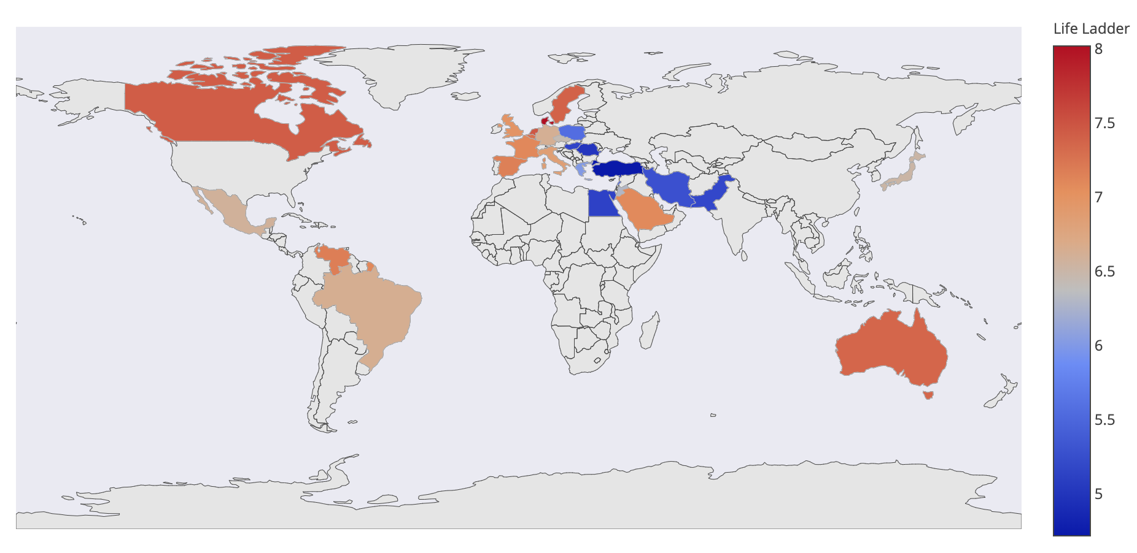
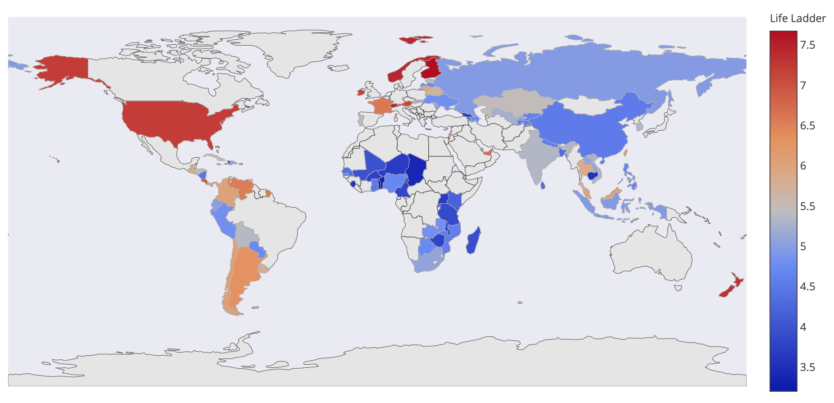
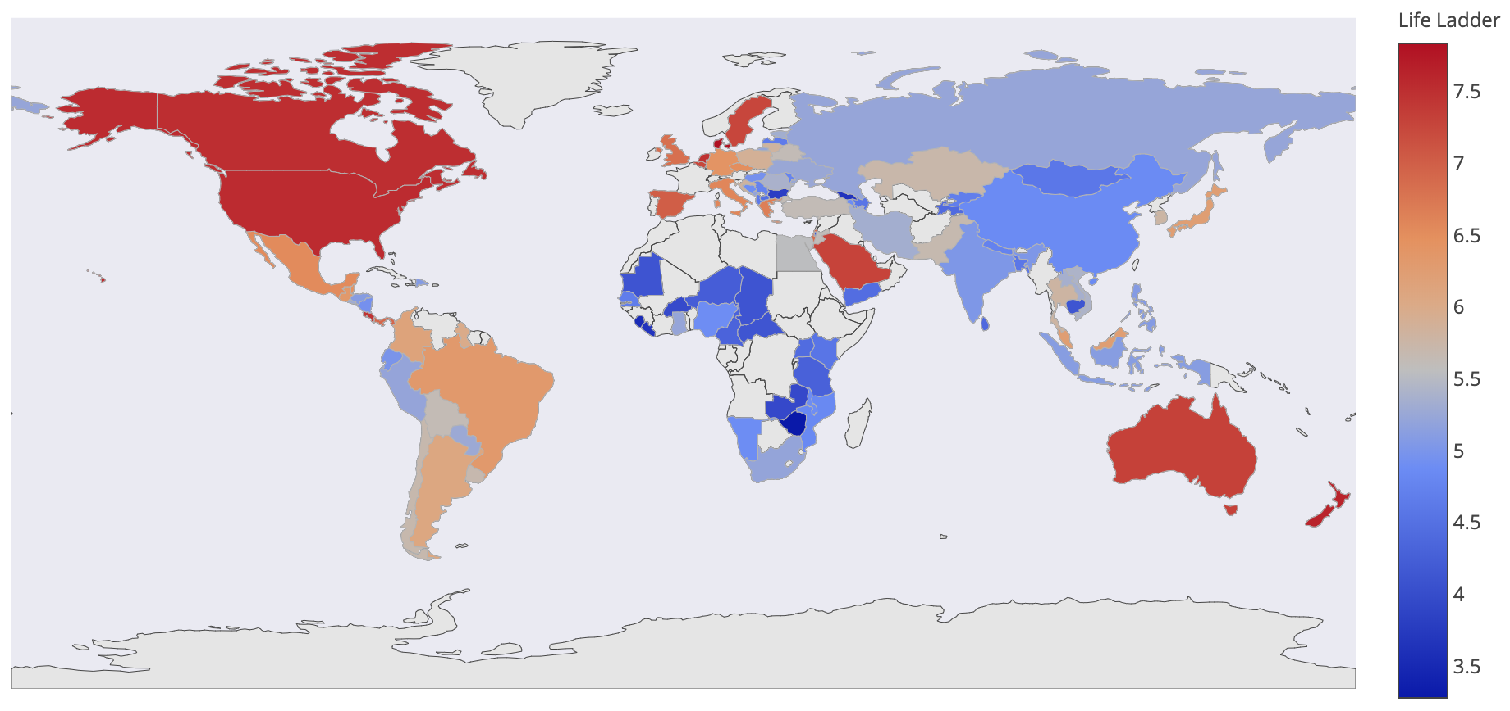
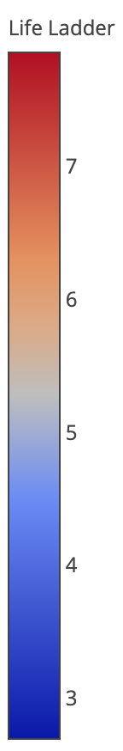
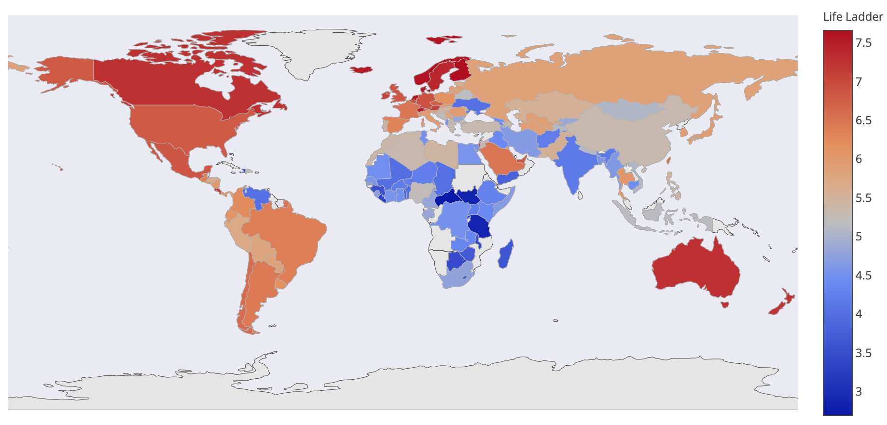
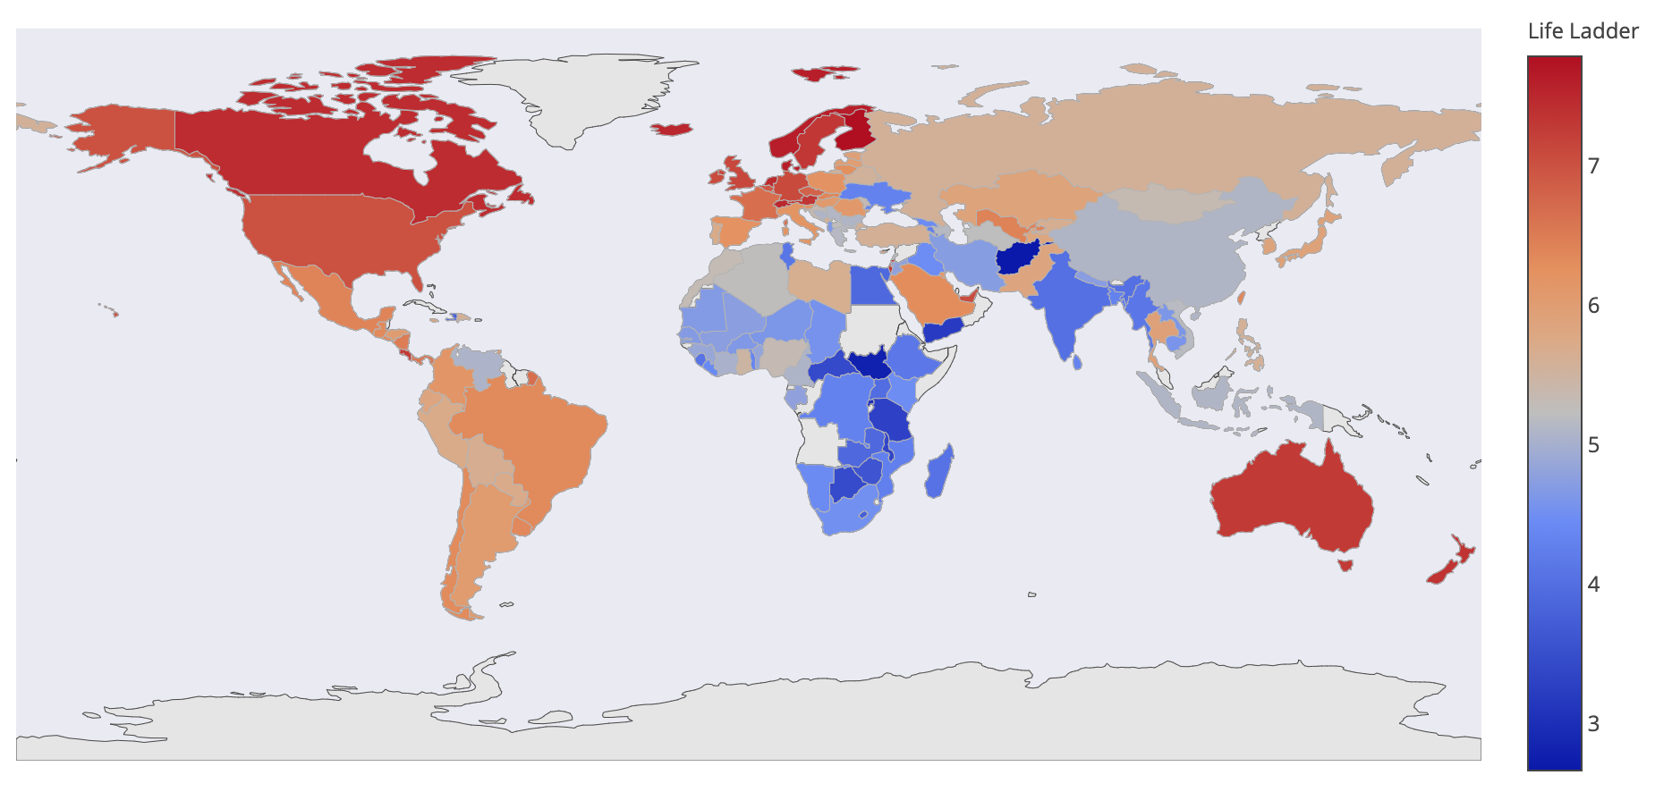
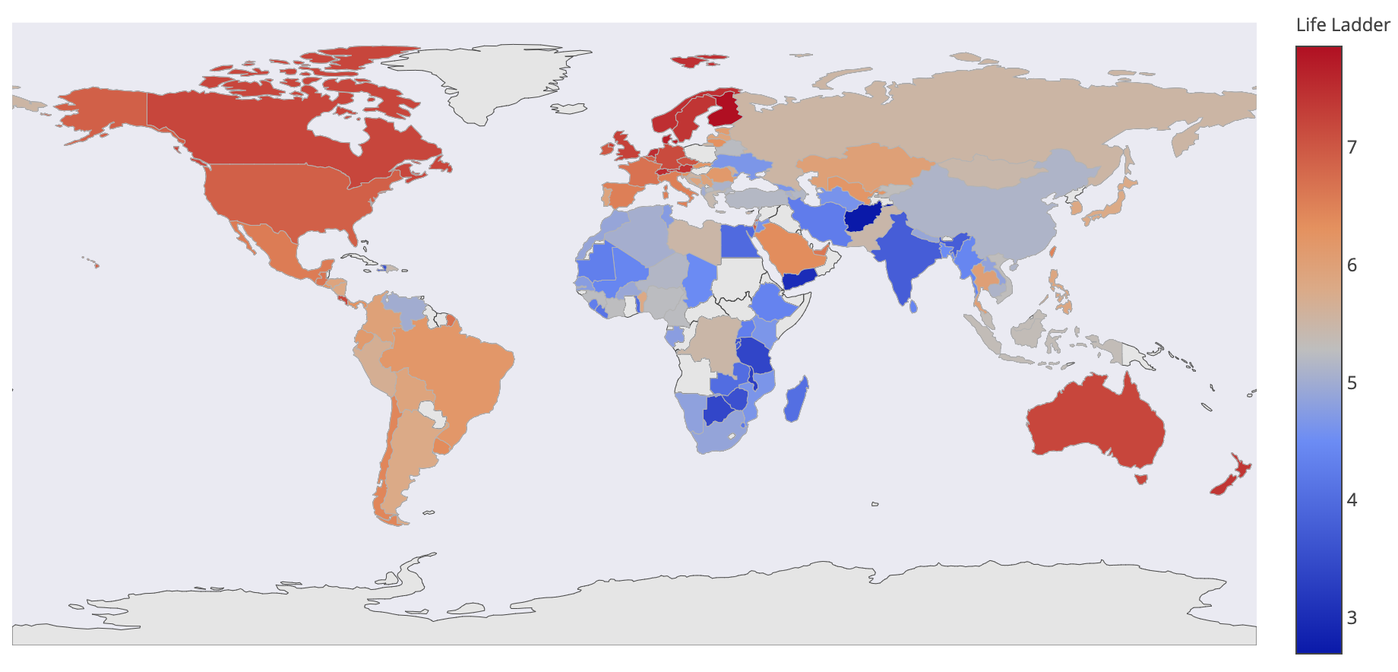
Now, let’s take a look at our…
Visualization
2005
2006
2007
2016
2017
2018
Background
Analysis
Prediction
Outcome
Conclusion

Slide 4
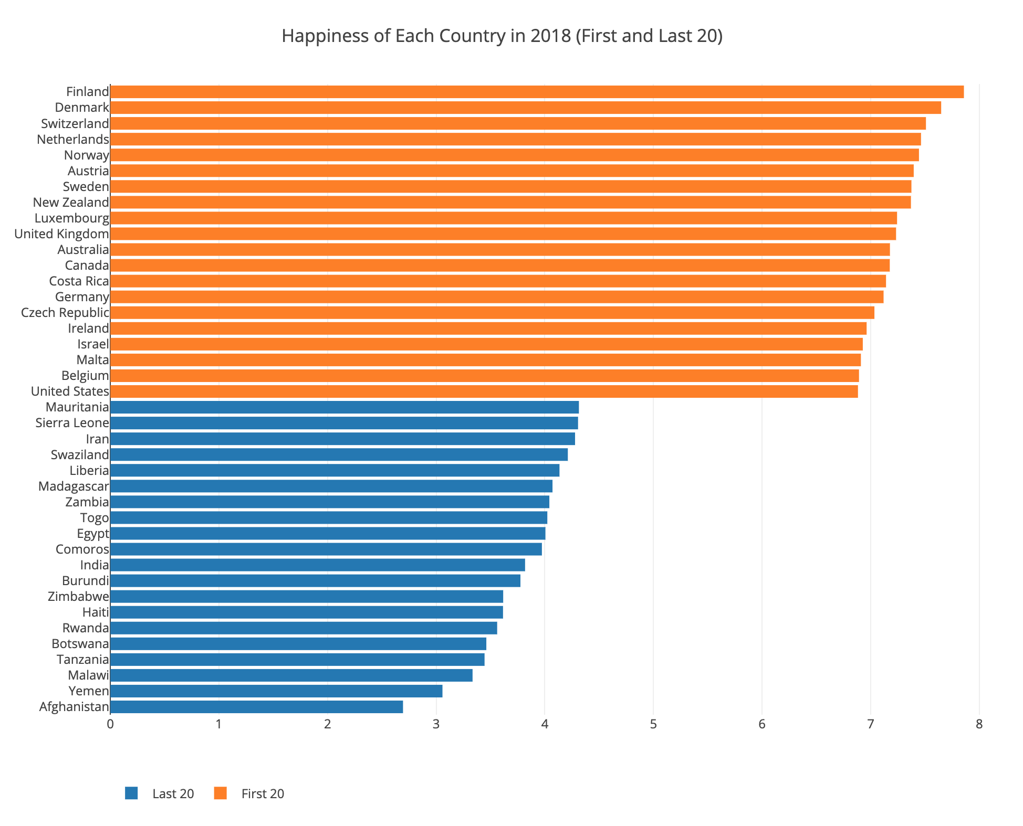
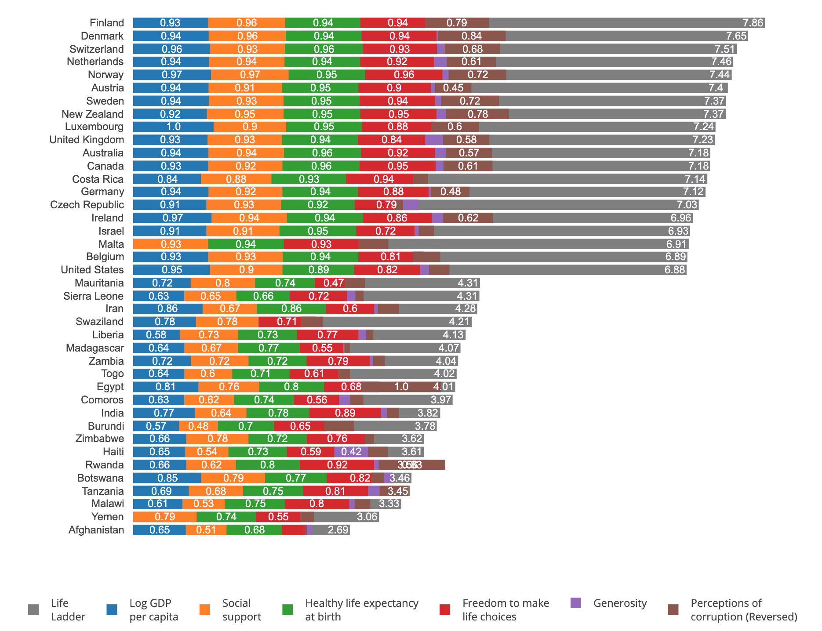
Now, let’s take a look at our…
Visualization
Countries' Happiness Scores in 2018 (First and Last 20)
Breakdown of Countries' Happiness Scores in 2018 (First and Last 20)
Background
Analysis
Prediction
Outcome
Conclusion

Slide 5
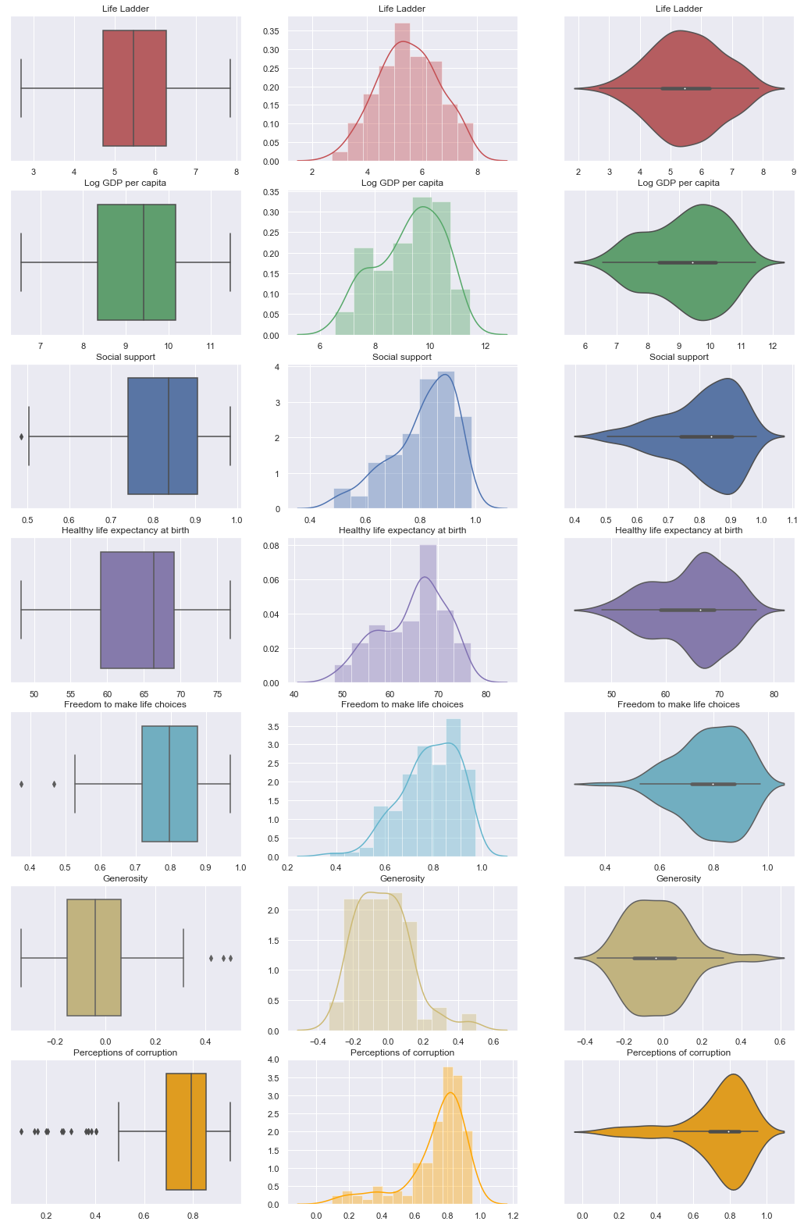
Now, let’s take a look at our…
Visualization
Background
Analysis
Prediction
Outcome
Conclusion

Slide 6
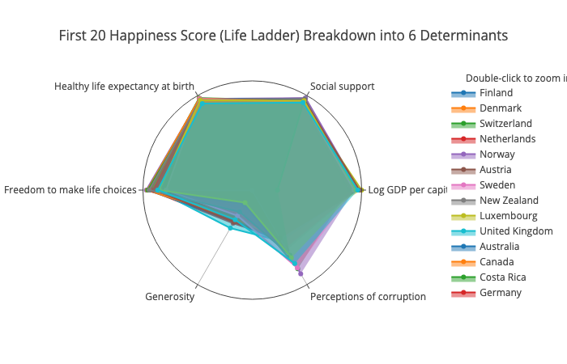
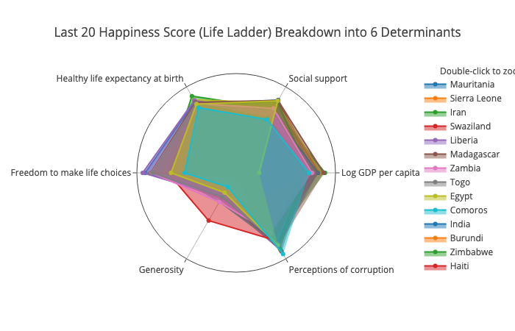
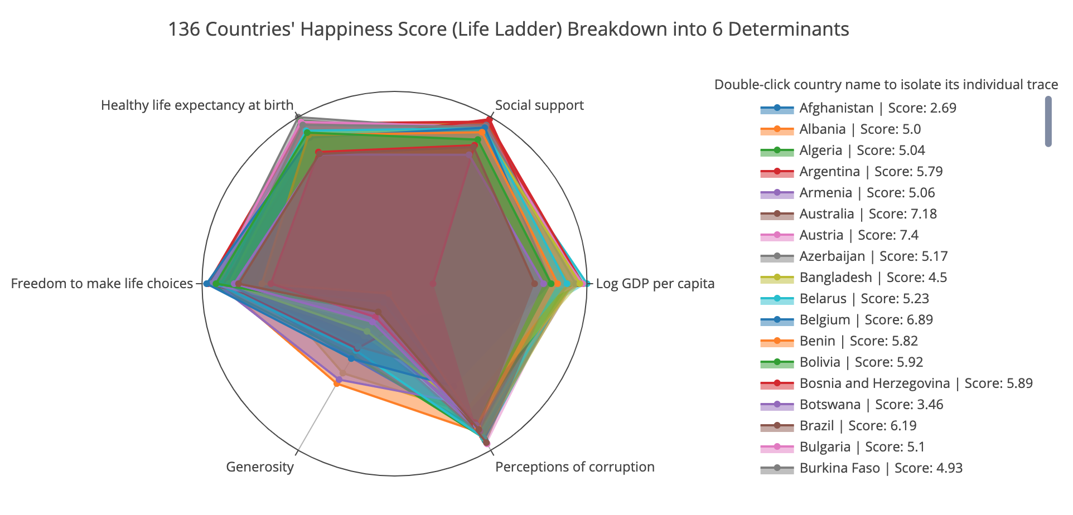
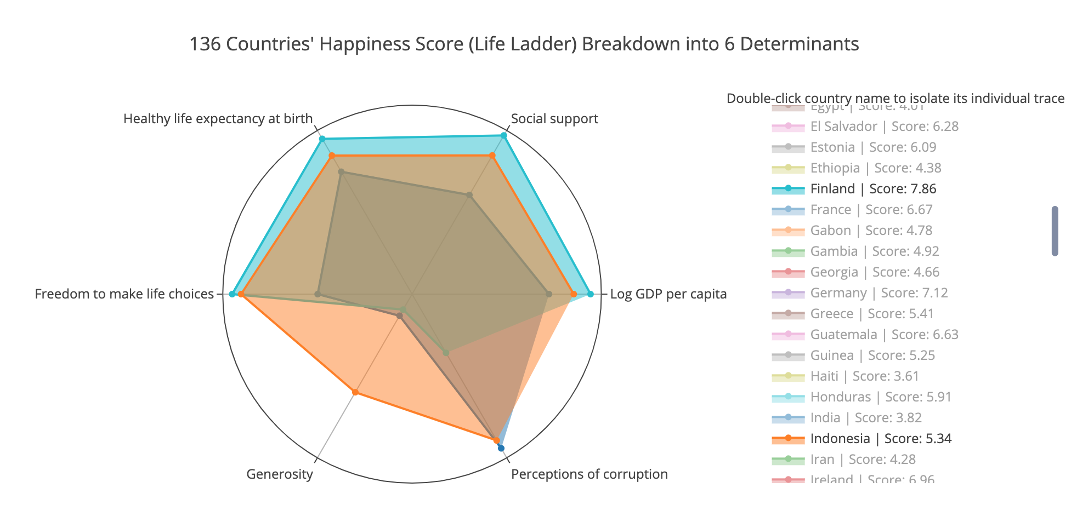
Now, let’s take a look at our…
Visualization
First 20 Happiness Score (Life Ladder) Breakdown into 6 Determinants
Last 20 Happiness Score (Life Ladder) Breakdown into 6 Determinants
136 Countries' Happiness Score (Life Ladder) Breakdown into 6 Determinants
Comparing Happiest, Unhappiest, and Most Generous Countries
Background
Analysis
Prediction
Outcome
Conclusion

Slide 7
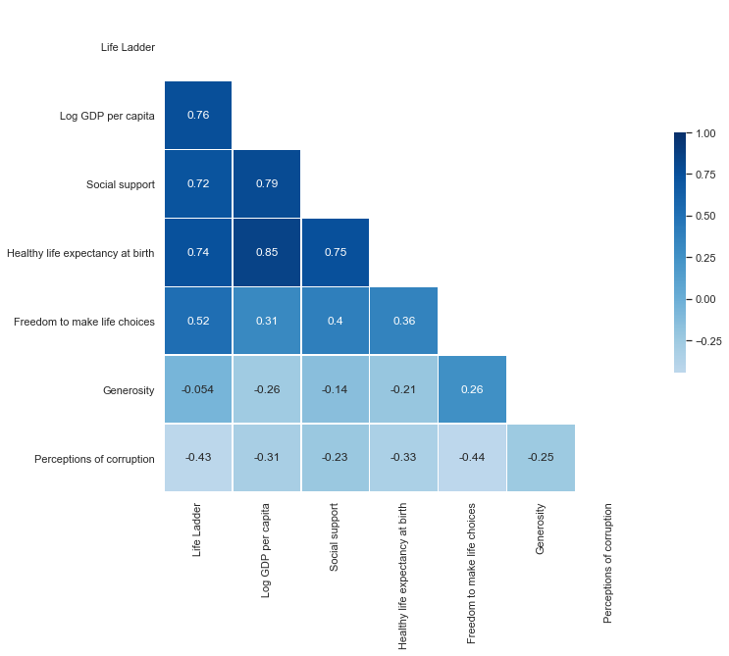
Now, let’s take a look at our…
Visualization
Background
Analysis
Prediction
Outcome
Conclusion

Slide 8
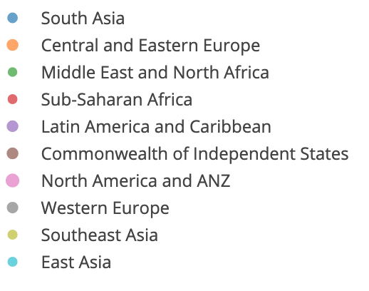
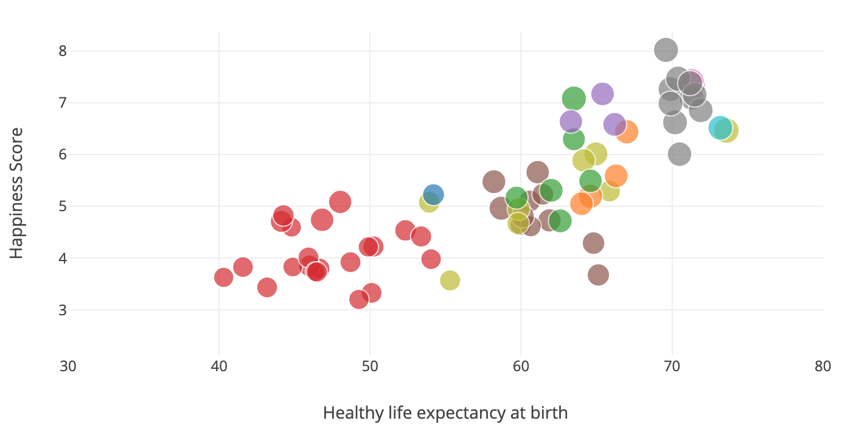
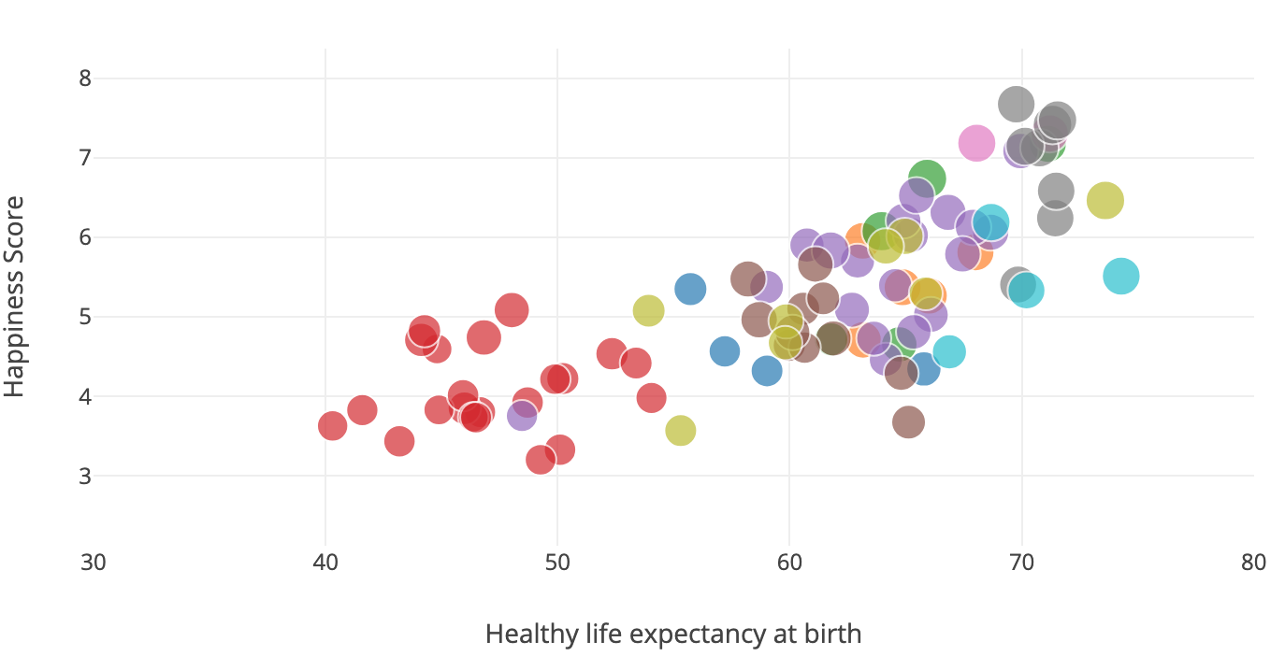
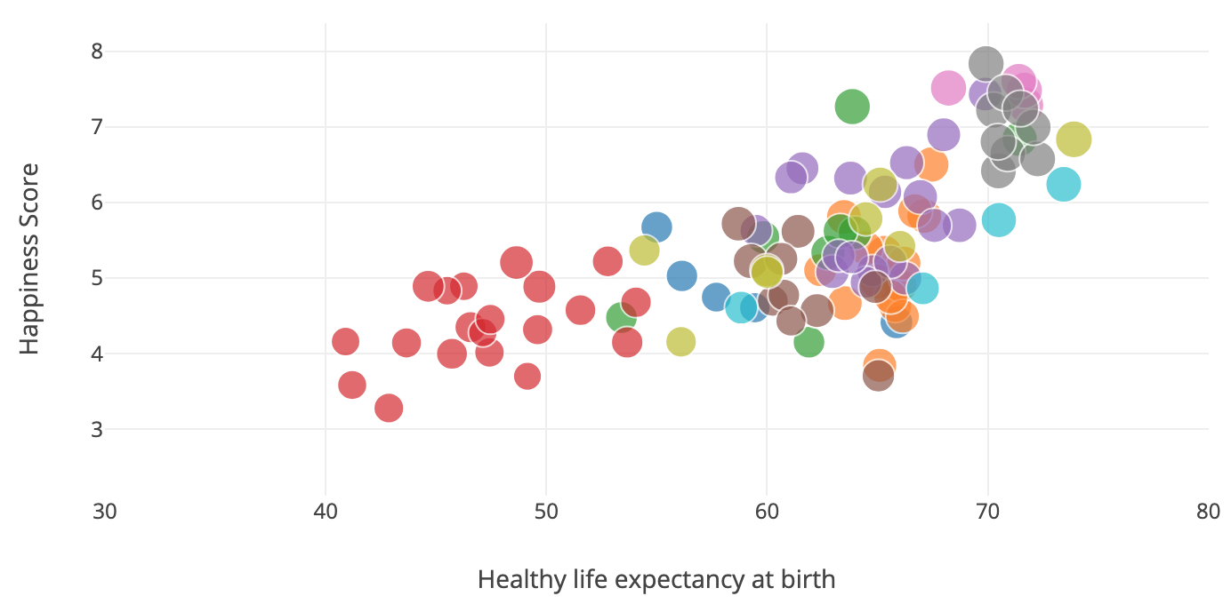
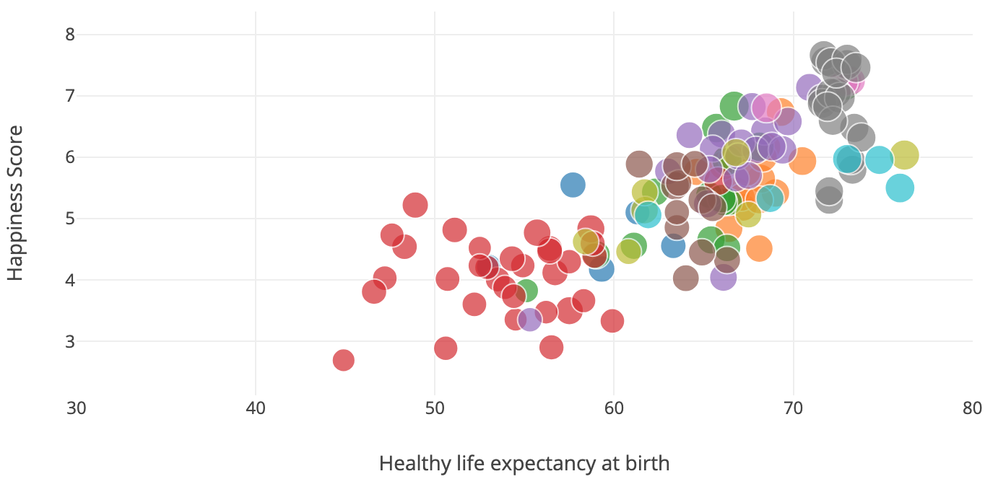
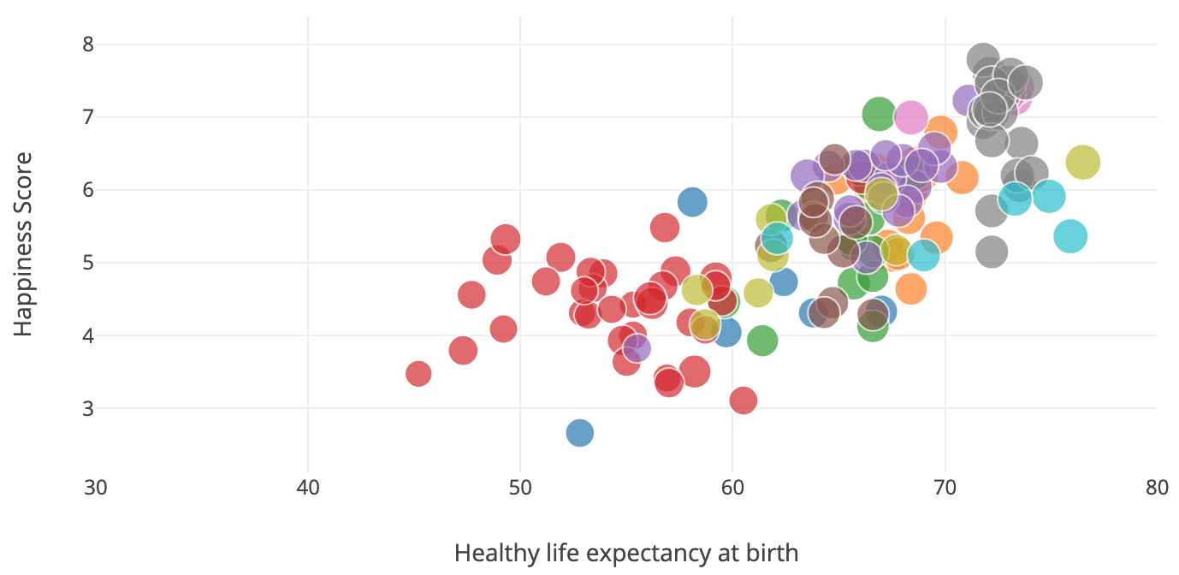
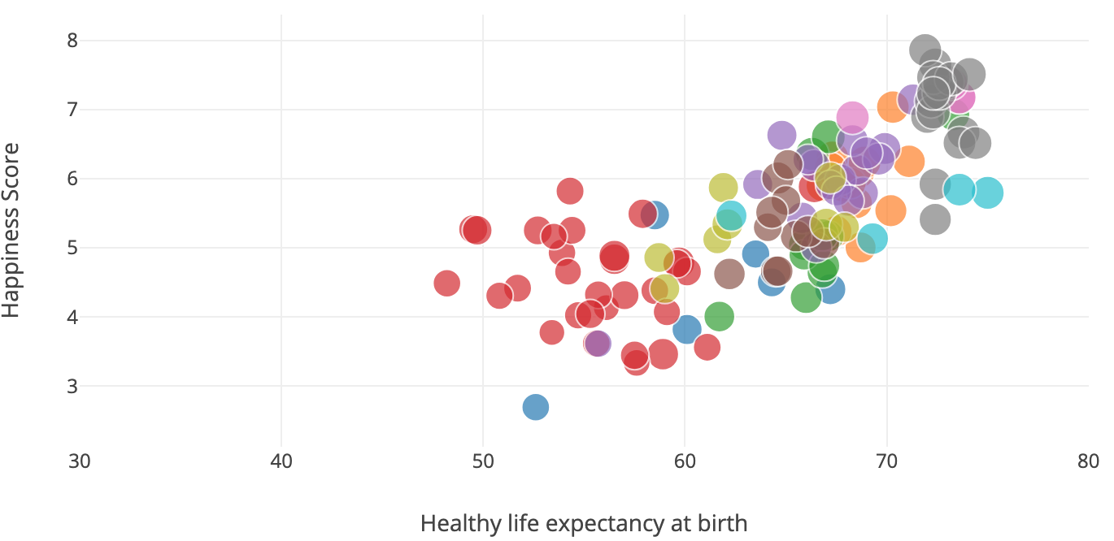
Now, let’s take a look at our…
Visualization
2005
2006
2007
2016
2017
2018
Background
Analysis
Prediction
Outcome
Conclusion

Slide 9
Now, let’s take a look at our…
Prediction
Predict each index for each country
Use the predicted indexes to predict happiness
Background
Visualization
Analysis
Outcome
Conclusion

Slide 10
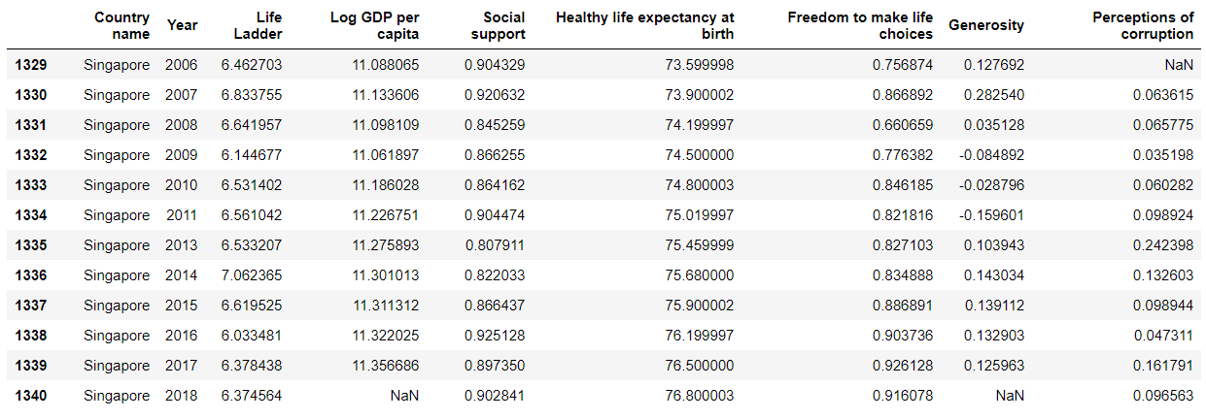
Now, let’s take a look at our…
Prediction
uni-variate linear regression for each column index
Predictions:
Background
Visualization
Analysis
Outcome
Conclusion

Slide 11
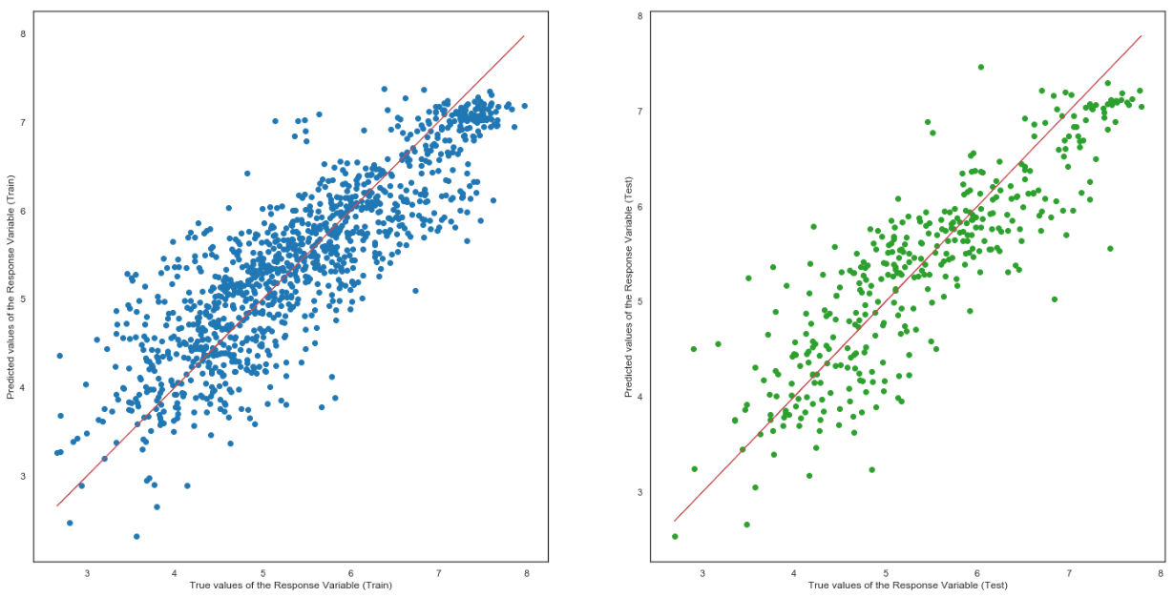
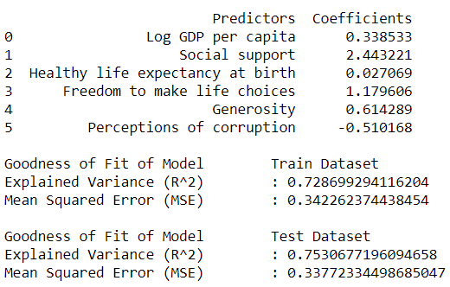
Prediction
√ after predicting the indexes for each country...
Predict happiness for each country by using all 6 indexes
Multi-variate Linear Regression
Background
Visualization
Analysis
Outcome
Conclusion

Slide 12
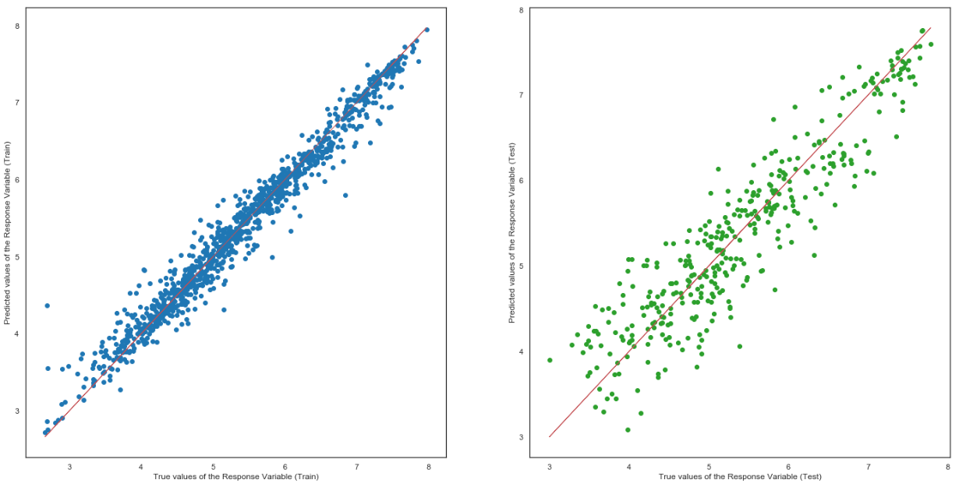
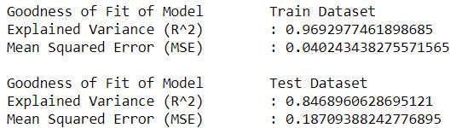
Prediction
Random Forest Regression
Background
Visualization
Analysis
Outcome
Conclusion

Slide 13
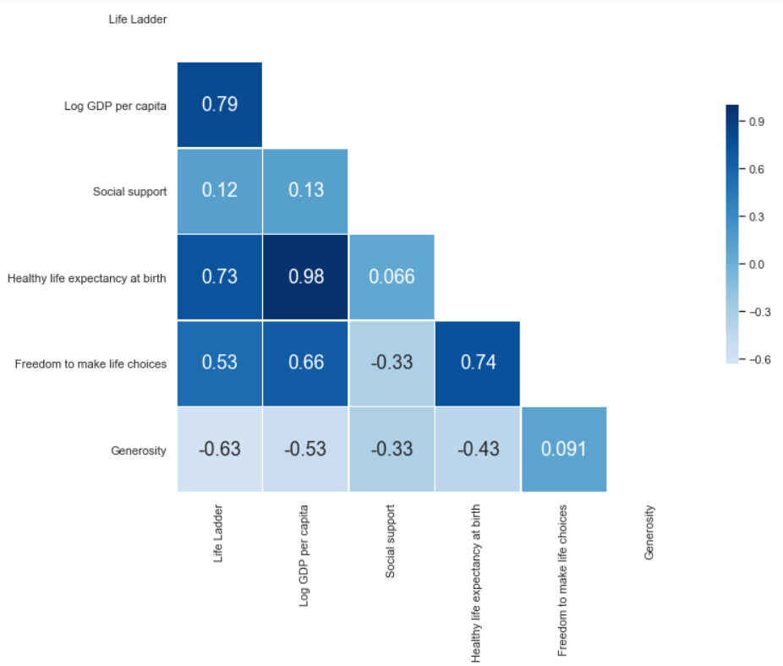
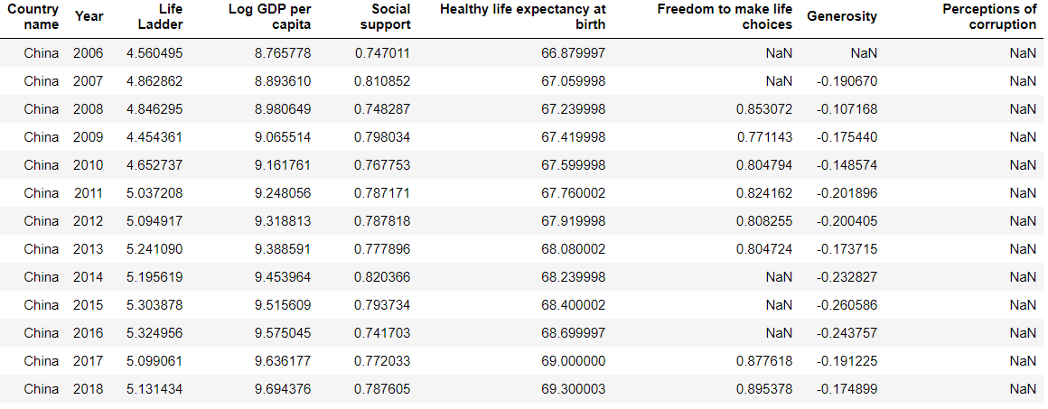
Prediction
Highest Correlation
Regression is great enough, but stats are not so ideal...
Uni-variate Linear Regression
Background
Visualization
Analysis
Outcome
Conclusion

Slide 14
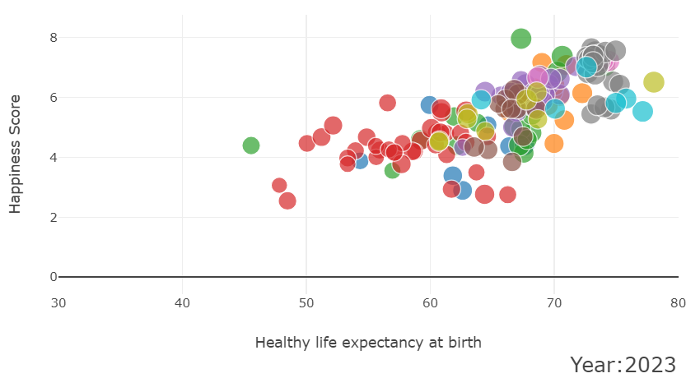
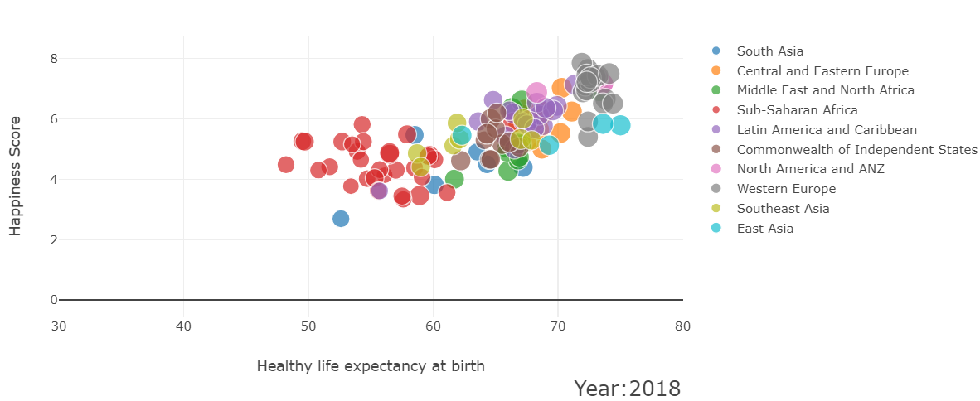
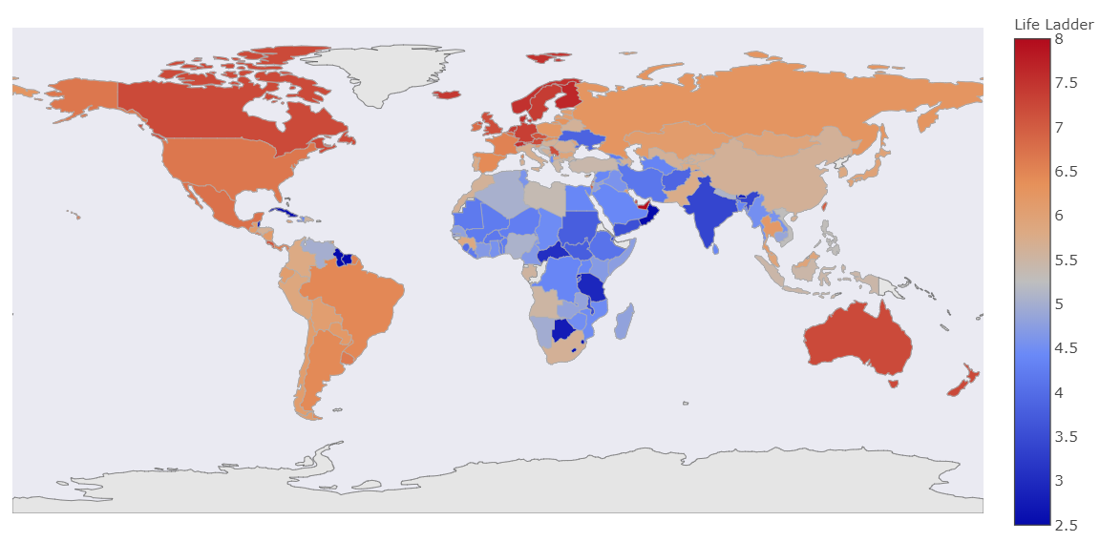
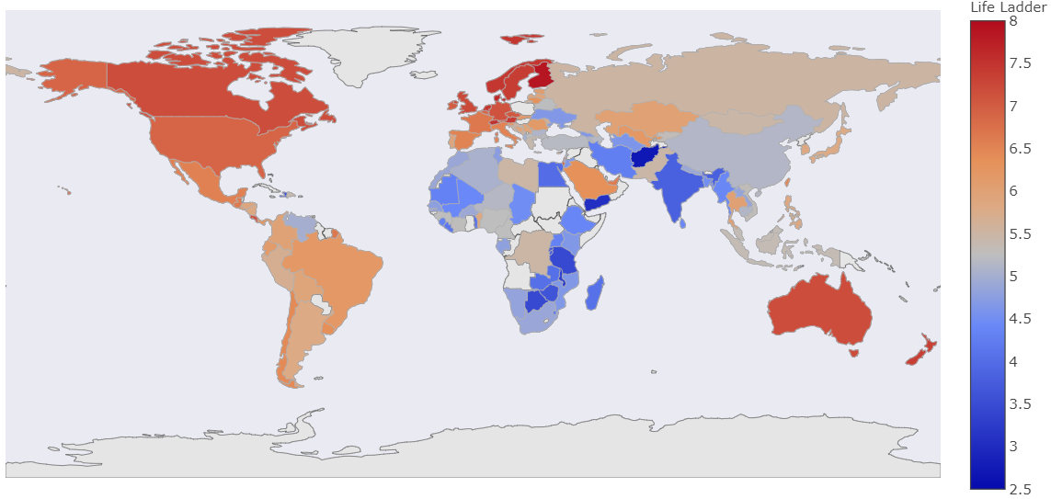
Prediction
World Happiness - Year 2018
World Happiness - Year 2023
Background
Visualization
Analysis
Outcome
Conclusion

Slide 15
So, what is our…
Outcome
Did we achieve our objective?
Yes
Anything interesting ?
Visualization
Regression model.
Background
Visualization
Analysis
Prediction
Conclusion
Notes:
Did we achieve our objective
YEAH. WE TRIED DIFFERENT MODELS TO HELP WITH OUR PRIDICTION. EVENTUALLY, WE ARE ABLE TO IMPLMENT A MODEL THAT PRIDICT PROMISING RESULT. AS MENTIONED BY XIAO YANG WHICH IS THE RANDOM FOREST.
Anything interesting
AS MENTIONED KEANE UNDER THE VISUALLISATION
WE OBSERVED THAT THE TOP 20 CORRUPTION ARE PRETTY LOW
BOTTOM 20 CORRUPTION ARE PRETTY HIGH.
Radar CHART WE OBSERVED THAT THE generosity and corruption has a low core relation with the life ladder
Lastly we observe that countries are getting more and more unhappiness and live shorter over the year when we tried using the multivariances regression to predict.

Slide 16
Finally, for our…
Conclusion
Learning points
Ploty
More efficient in python code.
Challenges
Data cleaning
Background
Visualization
Analysis
Prediction
Outcome
Notes:
Learning points :
We learn potly,
We become more efficient in python code.
Challenge
Data cleaning
To conclude we believe we have a brighter future in term of better GDP and life expectancy

Slide 17
Thanks for tuning in! Any Question?
Random data

